Slide 1
UNIT 4
Ensemble Learning and Random Forests

Slide 2
Ensemble Learning and Random Forests:
Voting Classifiers,
Bagging and Pasting,
Random Patches and Random Subspaces,
Random Forests,
Boosting,
Stacking

Slide 3



Ensemble Learning
Ensemble: a group of items viewed as a whole rather than individually
If a complex question is asked to thousands of random people, then aggregate their answers.
In many cases you will find that this aggregated answer is better than an expert’s answer.
This is called the wisdom of the crowd.
Similarly, if you aggregate the predictions of a group of predictors (such as classifiers or regressors), you will often get
better predictions than with the best individual predictor.
A group of predictors is called an ensemble;
thus, this technique is called Ensemble Learning, and an Ensemble Learning algorithm is called an Ensemble method.

Slide 4
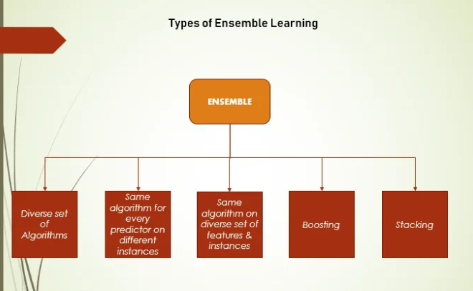






Most popular Ensemble methods:
Bagging
Boosting
Stacking
Random Forests and others

Slide 5
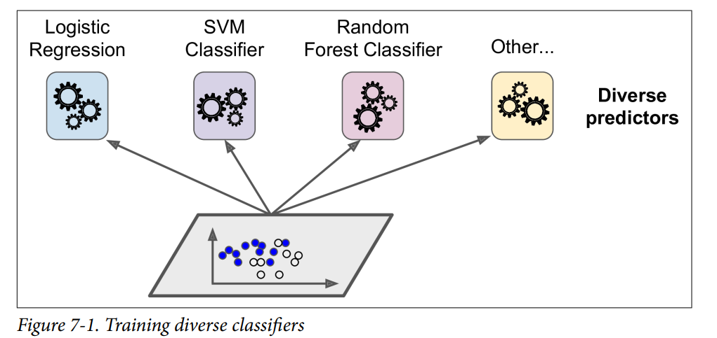

Type 1. Voting Classifiers – A diverse set of Algorithms
(different algorithms trained on the same instances.)
Suppose you have trained a few classifiers, each of it achieving individual accuracy values.
Example: a Logistic Regression classifier, an SVM classifier, a Random Forest classifier, a K-Nearest Neighbors classifier, and others
Based on our goal (Regression/Classification) we choose a set of diverse models, train them, aggregate the results of these models and come to a conclusion. This is done using voting classifiers.
This increases the chance that they will make very different types of errors, improving the ensemble’s accuracy.

Slide 6

Ensemble Learning
(also known as committee-based learning.)
Ensemble learning is a ML technique that combines the predictions of multiple models to improve the overall accuracy and performance of a system.
multiple models are trained to solve the same problem and their predictions are combined to produce a final prediction.
use voting strategies to determine the overall outcome.
The goal is to achieve better performance than any single model.
help address challenges like overfitting, underfitting, and excessive variance.
It can also improve the robustness of the system.

Slide 7
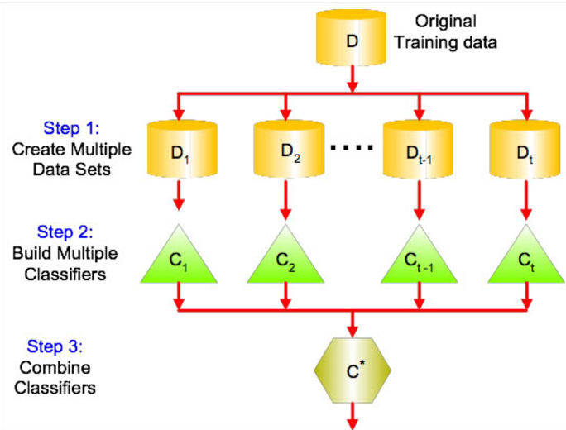


final prediction is made by combining the predictions of multiple individual models

Slide 8
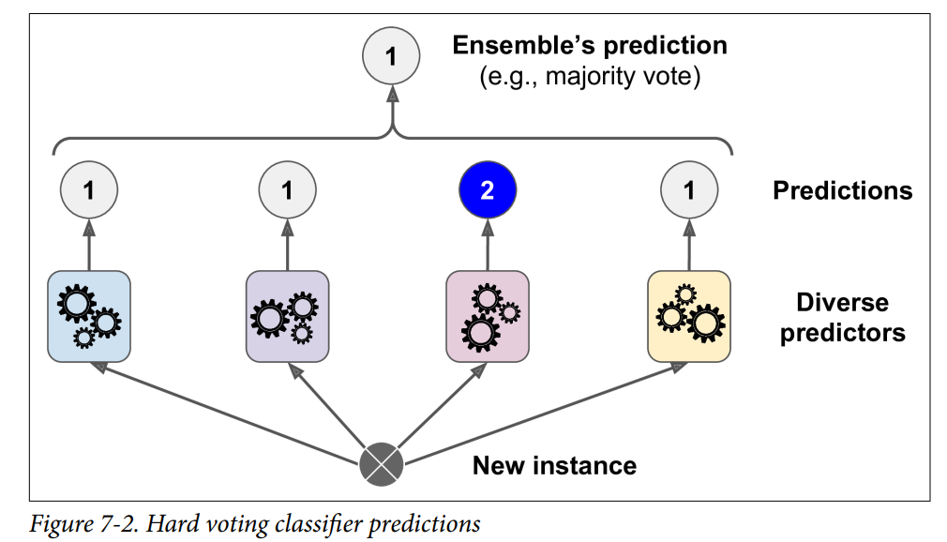




Voting Types – Hard Voting and Soft Voting
A better classifier aggregates the predictions of each classifier and predicts the class that gets the most votes.
This majority-vote classifier is called a hard-voting classifier.
Voting classifier achieves a higher accuracy than the best classifier in the ensemble.
Soft Voting

Slide 9



Ensemble Learning - Voting Types
Hard Voting – also known as majority voting
Each classifier in the ensemble makes its own prediction for each sample
The final prediction is the class label that receives the majority of votes from the individual classifiers.
Each classifier predicts a class label for a given sample.
The class label that appears most frequently among the predictions is selected as the final output.
For example, if 4 classifiers whose predictions are 1,1,2,1 then the ensemble’s prediction will be 1.
Only if classifiers are independent, then the ensemble can perform better than the individual low performing classifiers.
But they are trained on the same data

Slide 10

Soft Voting
Soft voting takes the predicted probabilities of each class for each classifier.
The final prediction is made based on the average of these probabilities.
The class with the highest average probability is chosen as the final output.
Each classifier provides a probability distribution over the classes for a given sample.
These probabilities are averaged (or summed) for each class.
The class with the highest average probability is selected as the final output.

Slide 11
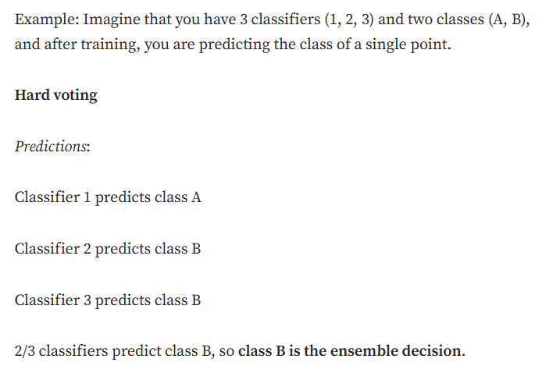
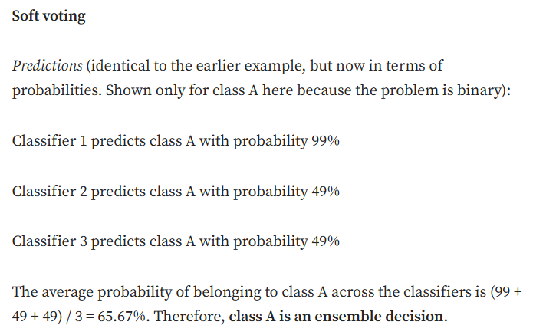





Slide 12
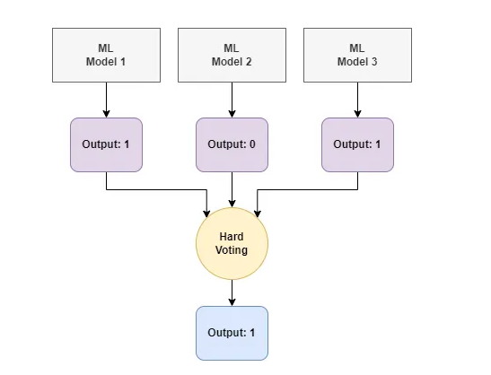
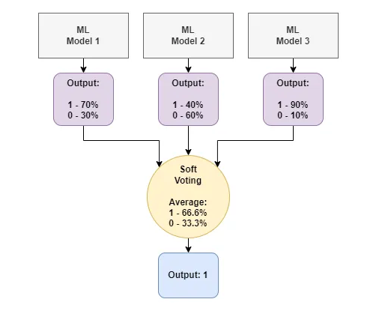

Hard Voting
Soft Voting

Slide 13








Bagging and Pasting
Type 2. Same algorithm for every predictor with different instances
learning techniques that create multiple subsets of training data to train separate models.
approach to get a diverse set of classifiers
use the same training algorithm for every predictor,
but to train them on different random subsets of the training set.
Bagging: Uses sampling with replacement, which means that data points can be chosen
more than once. also called as (bootstrap aggregating).
Pasting: when sampling is performed without replacement, it is called pasting.

Slide 14
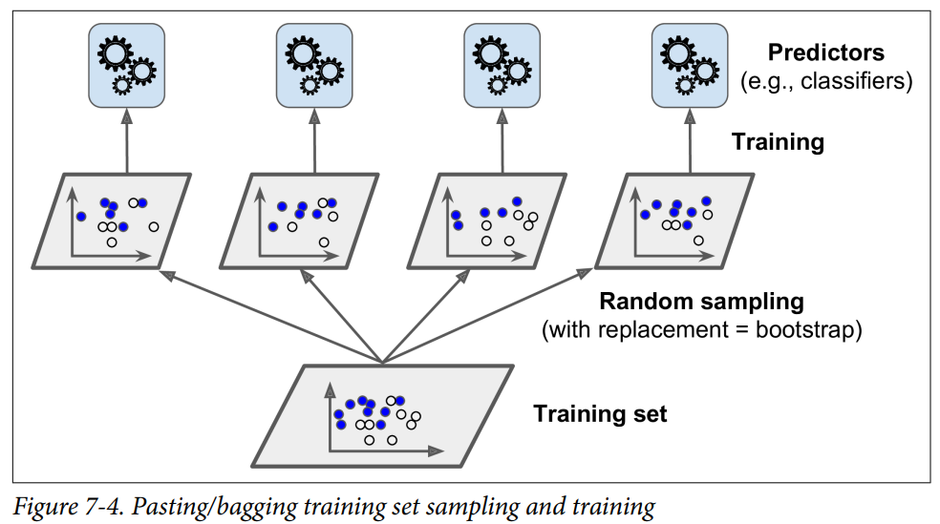


Bagging and Pasting
Use the same training algorithm for every predictor
Train each sample on different random subsets of the training set.
When sampling is performed with replacement, this method is called bagging (short for bootstrap aggregating).
When sampling is performed without replacement, it is called pasting.

Slide 15
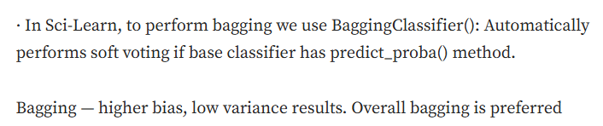

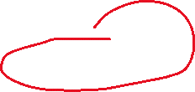
Bagging and Pasting
only bagging allows training instances to be sampled several times for the same predictor
· once models are trained, the ensemble will aggregate the predictions from all models.
· Aggregation — Mode: Classification
· Aggregation — Mean: Regression
· Aggregation reduces both bias and variance.

Slide 16
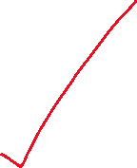

Bagging and Pasting
Once all predictors are trained, the ensemble can make a prediction for a new instance by simply aggregating the predictions of all predictors.
The aggregation function is typically the statistical mode (i.e., the most frequent prediction, just like a hard voting classifier) for classification, or the average for regression.
Each individual predictor has a higher bias than if it were trained on the original training set, but aggregation reduces both bias and variance.
Generally, the net result is that the ensemble has a similar bias
but a lower variance than a single predictor trained on the original training set.

Slide 17


Predictors can all be trained in parallel, via different CPU cores or even different servers.
Similarly, predictions can be made in parallel.
Advantage of bagging and pasting: they scale very well.
Bias:
difference between prediction values made by the model and actual values/expected values,
Variance: model’s sensitivity to fluctuations in the training data
specify the amount of variation in the prediction if different training data was used

Slide 18
Output graph compares the decision boundary of a single Decision Tree with the decision boundary of a bagging ensemble of 500 tree, both trained on the moons dataset.
The ensemble’s predictions will generalize much better than the single Decision Tree’s predictions:
the ensemble has a comparable bias but a smaller variance
it makes roughly the same number of errors on the training set, but the decision boundary is less irregular.

Slide 19


Bootstrapping introduces diversity in the subsets that each predictor is trained on, so bagging ends up with a slightly higher bias than pasting.
This means that predictors become less correlated so the ensemble’s variance is reduced.
Bagging often results in better models (it is generally preferred).
However, with spare time and CPU power you can use cross-validation to evaluate both bagging and pasting and select the one that works best.

Slide 20





Out-of-Bag Evaluation
In bagging approach some instances may be sampled several times for any given predictor, while others may not be sampled at all.
By default a BaggingClassifier samples m training instances with replacement (bootstrap=True), where m is the size of the training set.
For example:
This means that only about 63% of the training instances are sampled on average for each predictor.
The remaining 37% of the training instances that are not sampled are called out-of-bag (oob) instances.
Note that they are not the same 37% for all predictors.
set oob_score=True when creating a BaggingClassifier to request an automatic oob evaluation after training

Slide 21








Random Patches and Random Subspaces
Type 3 : Same algorithm on a diverse set of features & Instances
The BaggingClassifier class supports sampling the features as well.
This is controlled by two hyperparameters: max_features and bootstrap_features.
They work the same way as max_samples and bootstrap, but for feature sampling instead of instance sampling.
Thus, each predictor will be trained on a random subset of the input features
Useful when you are dealing with high-dimensional inputs (such as images).
Sampling both training instances and features is called the Random Patches method.
Sampling features results in even more predictor diversity, trading a bit more bias for a lower variance.

Slide 22
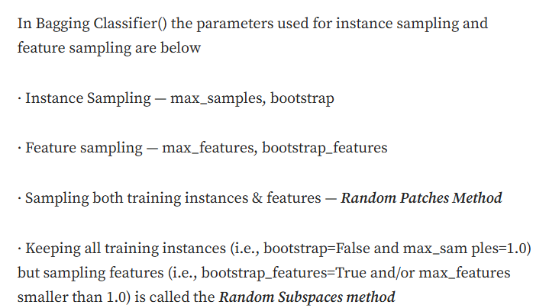



Slide 23

Random Forest Algorithm
supervised machine learning algorithm that combines the output of multiple decision trees to reach a single result
algorithm works by creating a forest of Decision Trees (DT) during the training phase
Each tree is constructed using a random subset of the data set to measure a random subset of features in each partition
The algorithm then outputs the prediction that the majority of trees in the forest select
The algorithm is an extension of the bagging method, which combines multiple models to improve accuracy and stability

Slide 24
Random Forests
A Random Forest is an ensemble of Decision Trees, generally trained via the bagging method (or sometimes pasting), typically with max_samples set to the size of the training set.
Use the RandomForestClassifier class, which is more convenient and optimized for Decision Trees
Similarly, there is a RandomForestRegressor class for regression tasks

Slide 25
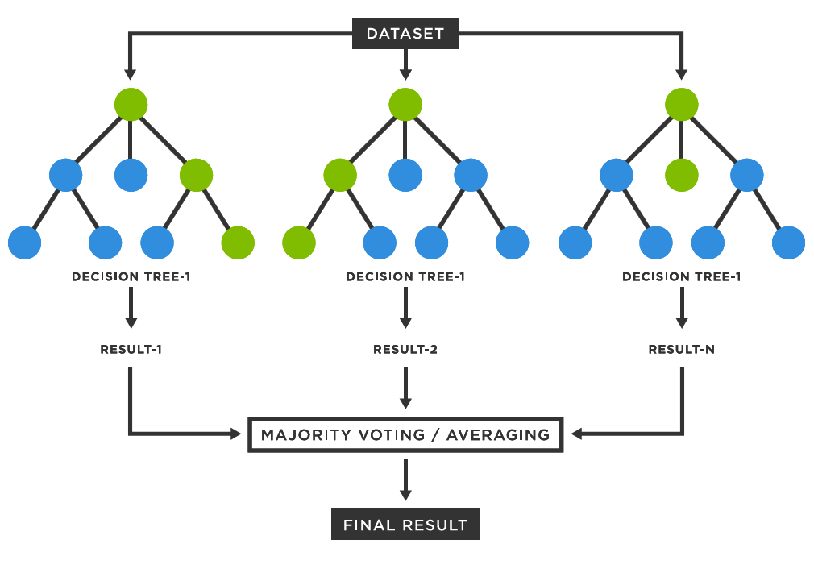
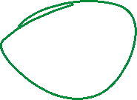

Random forests are widely used for classification and regression functions, which are known for their ability to handle complex data, reduce overfitting, and provide reliable forecasts in different environments.

Slide 26






Extra-Trees
When you are growing a tree in a Random Forest, at each node only a random subset of the features is considered for splitting
It is possible to make trees even more random by also using random thresholds for each feature rather than searching for the best possible thresholds
A forest of such extremely random trees is called an Extremely Randomized Trees ensemble(or Extra-Trees).
Trades more bias for a lower variance.
It also makes Extra-Trees much faster to train than regular Random Forests since finding the best possible threshold for each feature at every node is one of the most time-consuming tasks of growing a tree.
How to?
Create an Extra-Trees classifier using Scikit-Learn’s ExtraTreesClassifier class.

Slide 27


Feature Importance
Random Forests helps to measure the relative importance of each feature.
By looking at how much the tree nodes that use that feature reduce impurity on average
Scikit-Learn computes this score automatically for each feature after training, then it scales the results so that the sum of all importances is equal to 1.
You can access the result using the feature_importances_ variable.
Random Forests are very handy to get a quick understanding of what features matter, in particular if you need to perform feature selection.

Slide 28
Boosting
Boosting (hypothesis boosting) refers to any Ensemble method that can combine several weak learners into a strong learner.
The general idea of most boosting methods is to train predictors sequentially, each trying to correct its predecessor.
There are many boosting methods available, but the most popular are AdaBoost (Adaptive Boosting) and Gradient Boosting.

Slide 29
AdaBoost
A way for a new predictor to correct its predecessor by paying a bit more attention to the training instances that the predecessor underfitted.
This results in new predictors focusing more and more on the hard cases.

Slide 30
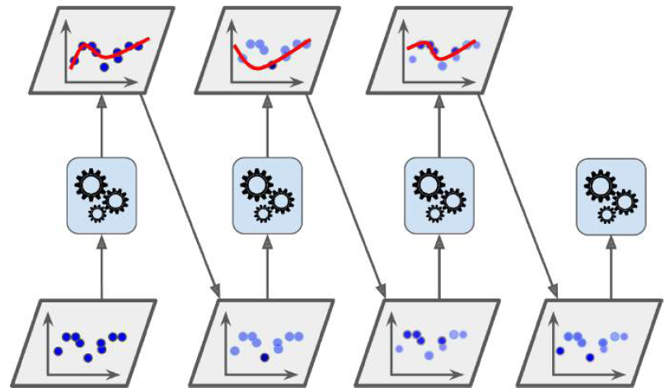
Example
To build an AdaBoost classifier, a first base classifier (such as a Decision Tree) is trained and used to make predictions on the training set.
The relative weight of misclassified training instances is then increased.
A second classifier is trained using the updated weights and again it makes predictions on the training set, weights are updated, and so on.

Slide 31
Gradient Boosting
Gradient Boosting works by sequentially adding predictors to an ensemble, each one correcting its predecessor.
However, instead of tweaking the instance weights at every iteration like AdaBoost does, this method tries to fit the new predictor to the residual errors made by the previous predictor.

Slide 32
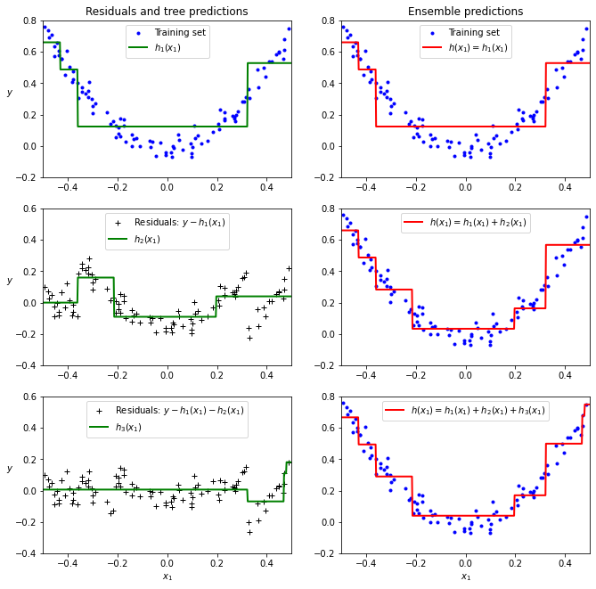

Slide 33
Stacking
Stacking (stacked generalization).
Idea:
instead of using trivial functions (such as hard voting) to aggregate the predictions of all predictors in an ensemble, train a model to perform the aggregation.
example

Slide 34
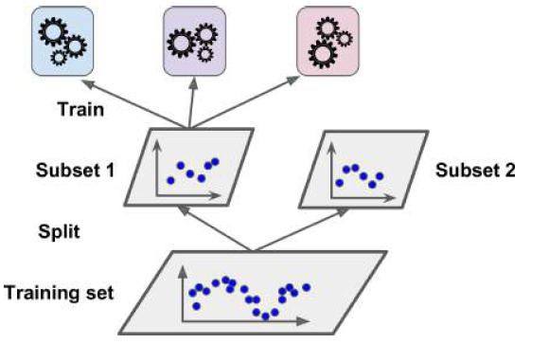
Training the blender
A common approach is to use a hold-out set.
First, the training set is split into two subsets.
The first subset is used to train the predictors in the first layer
Training the first layer

Slide 35
https://towardsdatascience.com/overview-ensemble-learning-made-simple-d4ac0d13cb96

